Slide 1
Euplectella sp. Skeleton Lammps_9/1

Slide 2
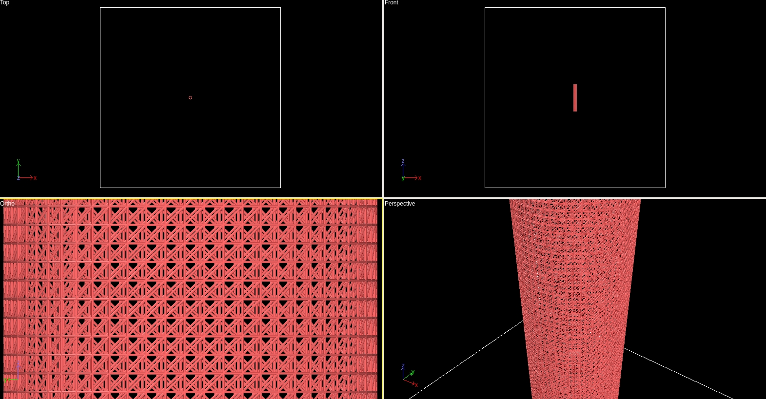
平衡前模型態

Slide 3
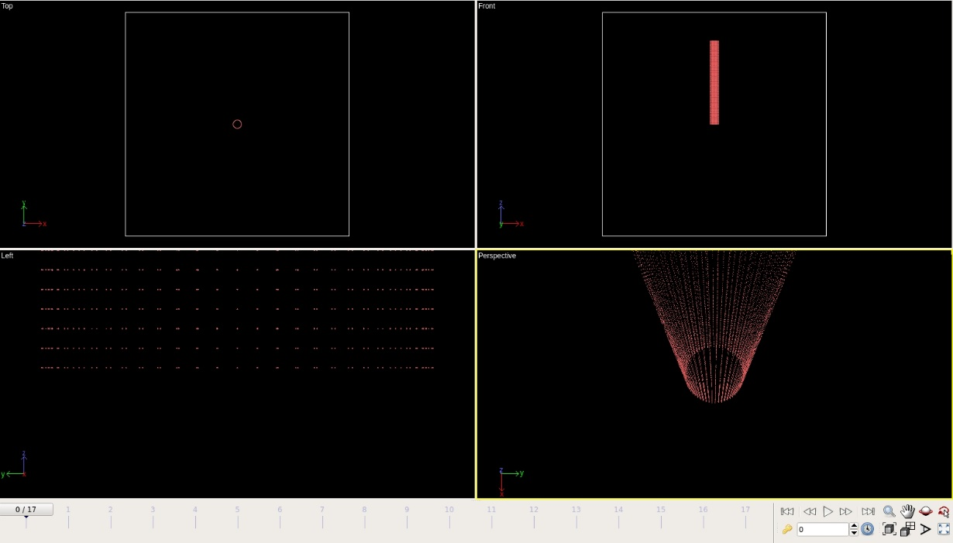
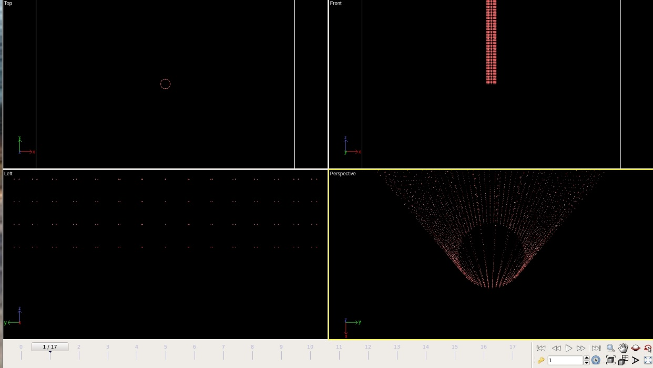
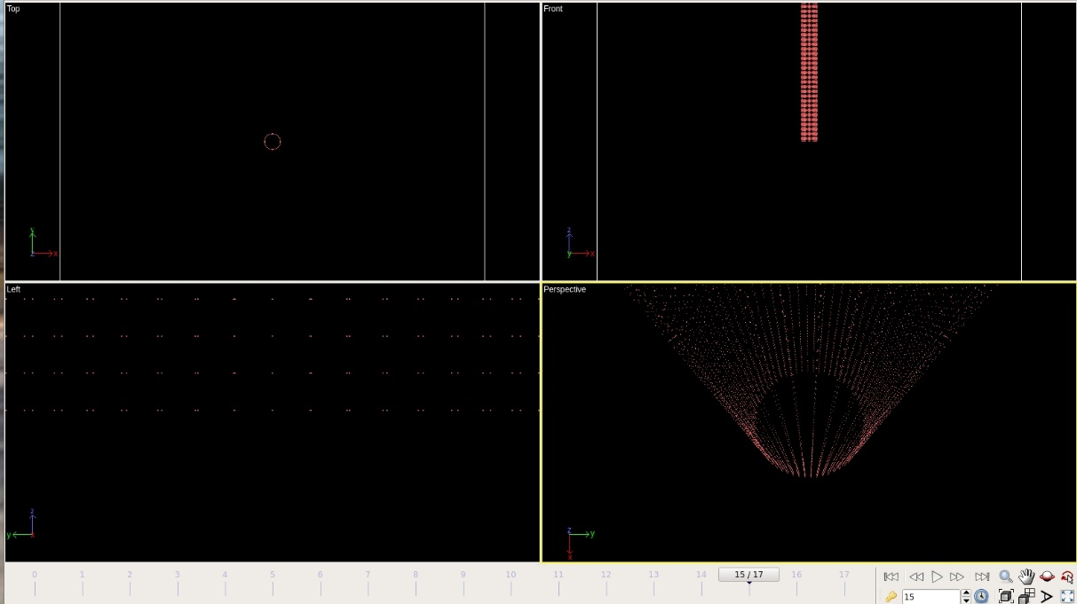
Time step 0
Time step 100
Time step 1500

Slide 4
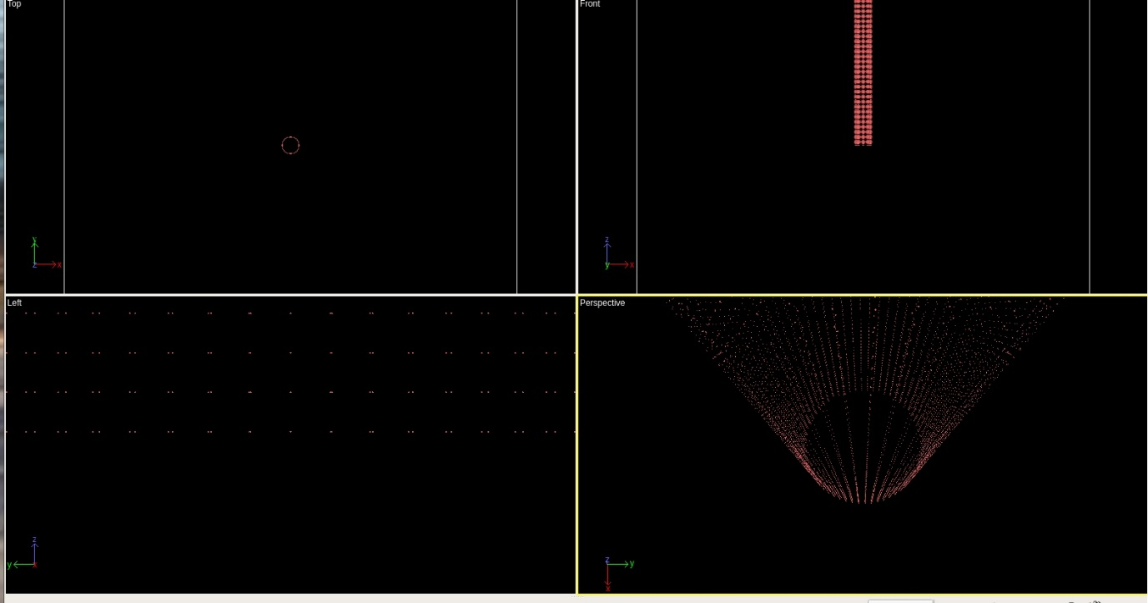
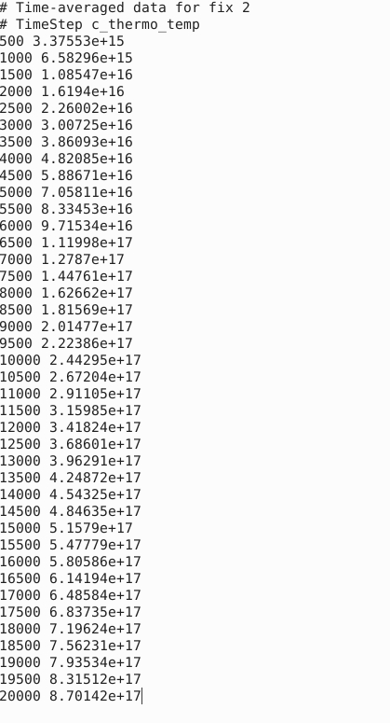
Time step 20000

Slide 5
Figure bond error
dump bond/local
dump custom

Slide 6
Future work
Use dump image or dump movie command
Solve temp unstable problem

